Slide 1

END SEMISTER PROJECT
DESIGN AND ANALYSIS OF ALGORITHMS
CONNECTED COMPONENTS AND RELATED ALGORITHMS USING LINEAR ALGEBRA
TEAM - 11

Slide 2
OUR PRESENTATION FLOW
BFS - algebraic way
using BFS and finding Predecessors and Descendants
SCC - divide and conquer style
SCC - parallelizing the regular DFS algorithm
Graph Contraction

Slide 3
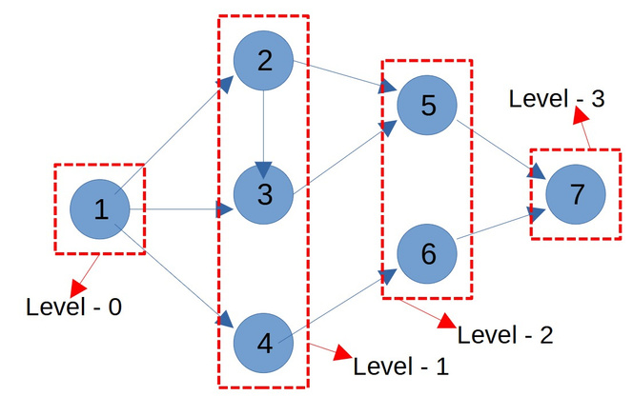

BREADTH-FIRST SEARCH
Using Matrix Algebra
level = 0
we will start from level 0
d = [ ]
take an Array D i.e distance from the Root
or the level of the particular node in the bfs tree
Frontier
f=[ ]
frontier is the last set of nodes labeled with latest level.
The node that we are goin to start with
In the next iteration we are going to explore all the neighbours of the frontier

Slide 4
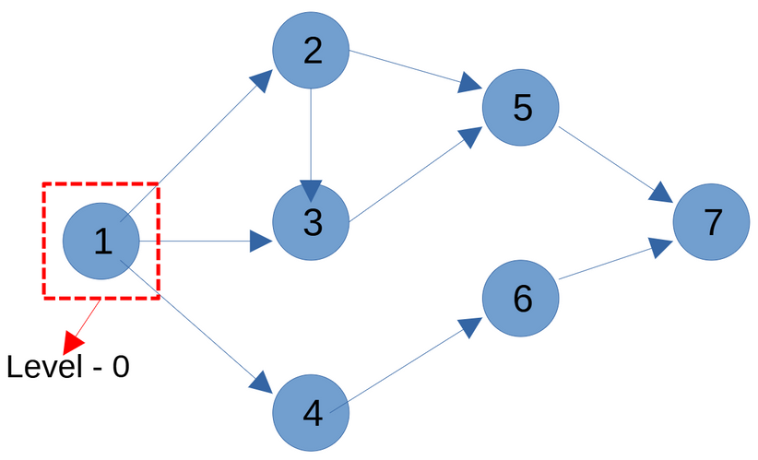

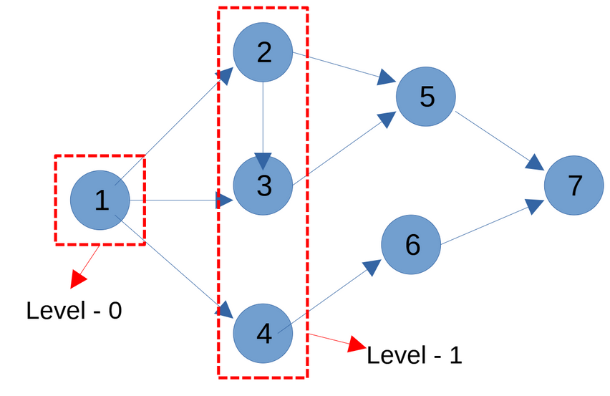
level = 0
1 2 3 4 5 6 7
d = [ 0 ]
f = [ 1 0 0 0 0 0 0]
d - tells the level,
infinity means not connected for now
f - frontier

Slide 5
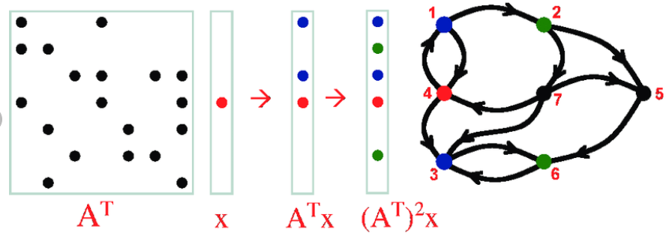
frontiers changing
f
f '
f ''

Slide 6
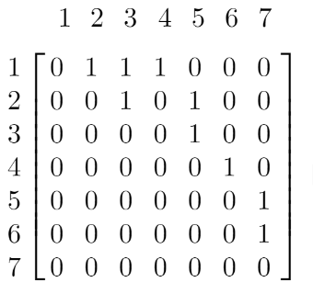
node j is in current frontier
f[j] = 1
Adjacency Matrix:
node j
new node is visited
Edge
node k
new frontier
u[k] = 1
If there is some j s.t ; f [ j ] & ajk = 1

Slide 7
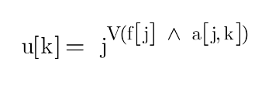
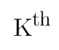

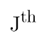

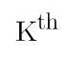


u is set to 1 if for some j ,
both are 1
The above is not the true form of multiplication
T
we do dot product => matrix-vector product

Slide 8
PSEUDO CODE:
while (f=0)
{
u = A^T * f
f' = u & (d )
update d with all elements where f' =1
set d[.] = level + 1
level = level + 1
f = f'
}
level = 0
1 2 3 4 5 6 7
d = [ 0 ]
f = [ 1 0 0 0 0 0 0]
Time Complexity is n^2 - matrix vector multiplicsstion takes the max

Slide 9

A DIVIDE-AND-CONQUER ALGORITHM
FOR Identifying
Strongly Connected Components
TEAM - 11

Slide 10
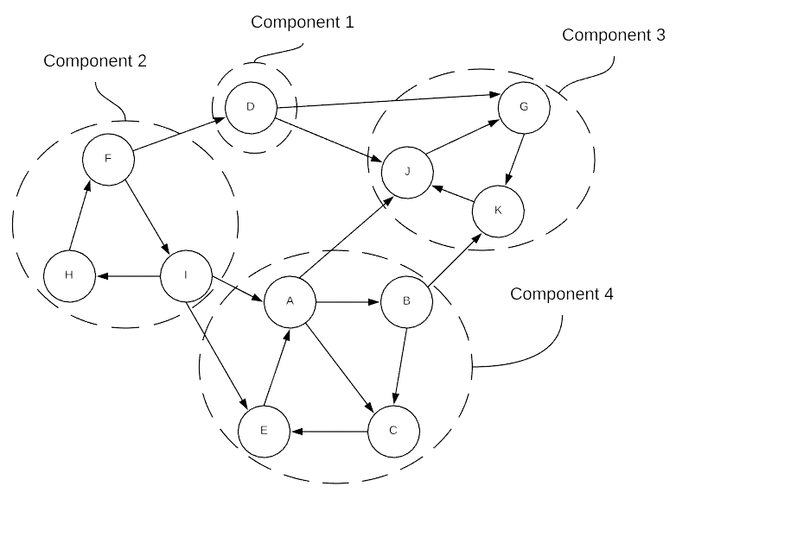
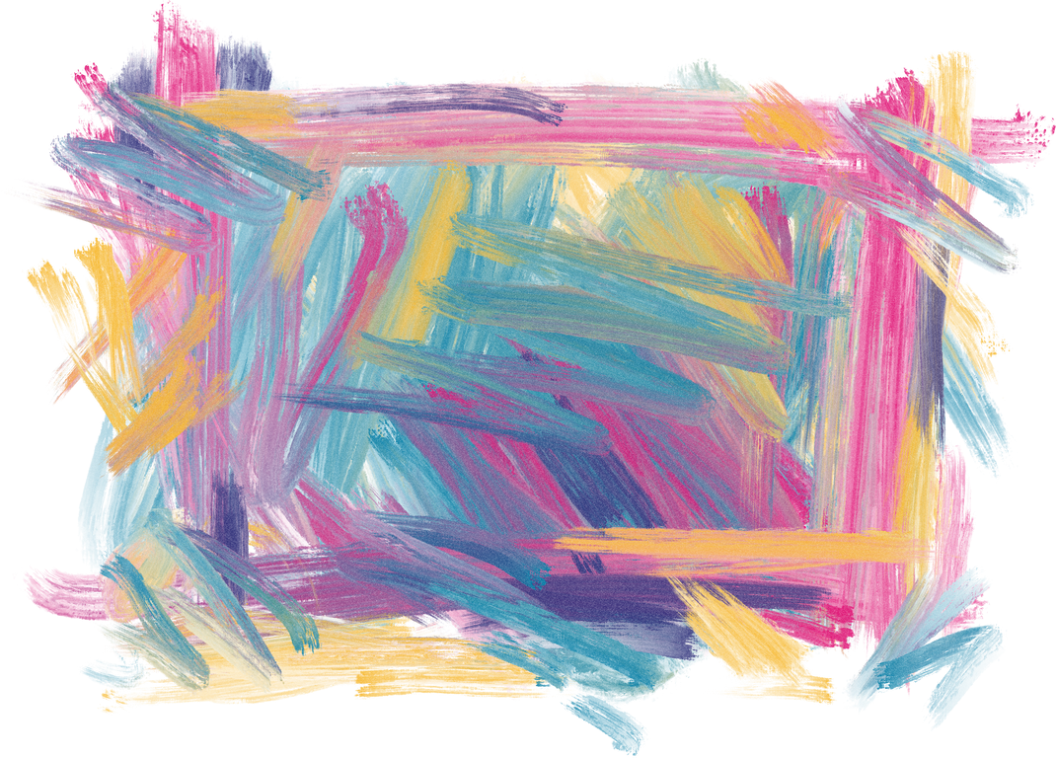
Strongly Connected Components
A strongly connected component is the portion of a directed graph with a path from each vertex to another vertex.
In the example, we can observe that every vertex is directly connected to all the vertex's in the respective component.

Slide 11

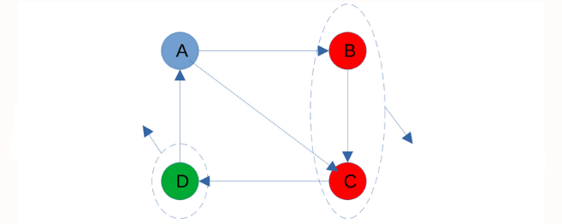
Predecessors and Descendants
Predecessors of A are nodes from which A is reachable and are found by a breadth-first search in G.
Descendants are found by a breadth-first search in G'.
Immediate predecessors
of A
Immediate Descendants of
A
B,C,D are all predecessors and descendants of A

Slide 12
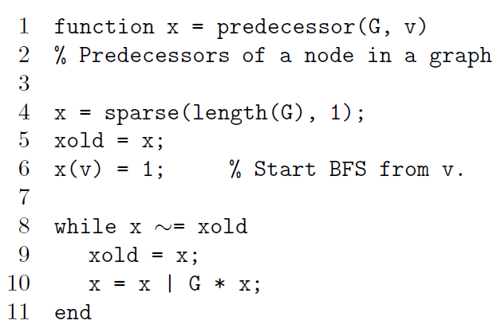
Pseudocode
IT IS BASED
ON BFS

Slide 13
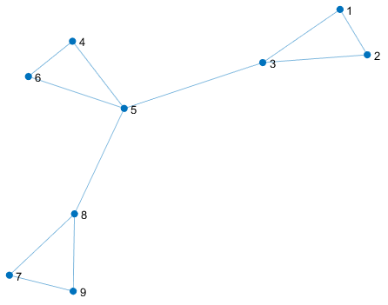
How to find the strongly connected components of the graph

Slide 14
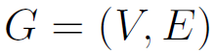
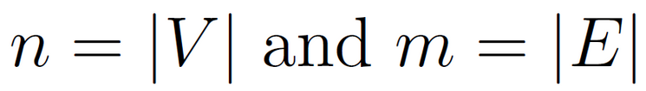
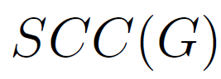
PRILIMINARIES
directed graph with vertex set V and directed-edge set E
A strongly
a connected component of G is a maximal subset S of V such that each vertex
in S is reachable from every other vertex in S.
- Strongly connected components of G
TEAM - 11

Slide 15
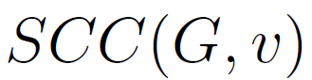
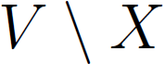
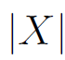
SCC(G) is a partition of V
The unique element of SCC(G) that contains v is denoted by
denotes the subset of vertices in V which are not in a subset X
The size of vertex set X is denoted by -
TEAM - 11

Slide 16
Desc(G, v), is the subset of vertices in G that are reachable from v.
Pred(G, v), is the subset of vertices from which v is reachable.
FROM THIS SUBSET OF VERTICES, WE WILL FORM A SUBGRAPH
TEAM - 11

Slide 17
The set of vertices that is neither reachable from v nor reach v is
called the remainder, denoted by
TEAM - 11

Slide 18
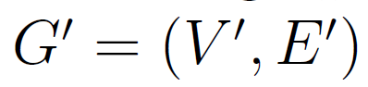
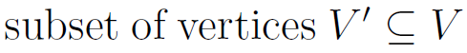
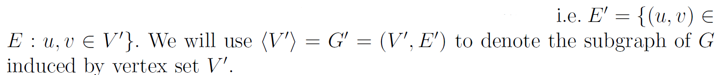
G = (V,E)
the induced subgraph
contains all edges of G connecting vertices of V'
TEAM - 11

Slide 19
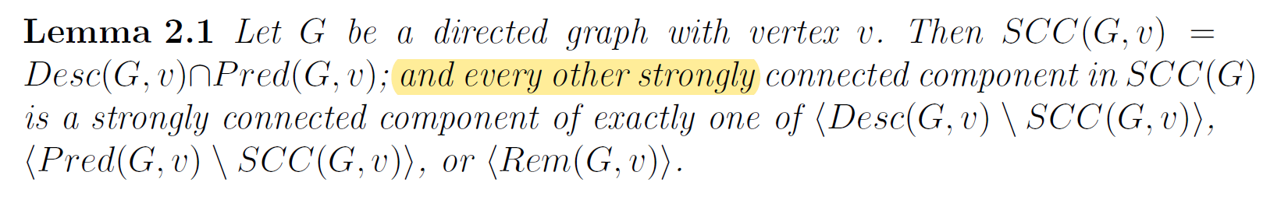
LOGIC
TEAM - 11

Slide 20
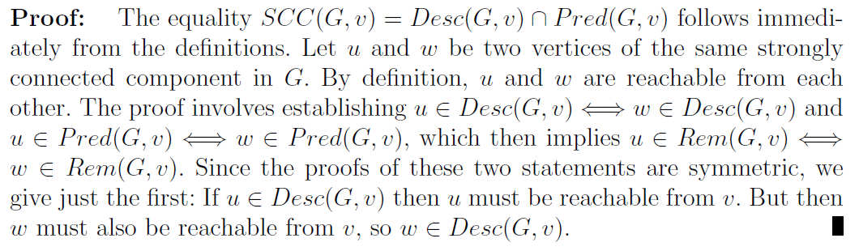
Credits : Don Coppersmith and Lisa Fleischer and
Bruce Hendrickson and Ali Pınar
https://escholarship.org/uc/item/1hx5n2df
TEAM - 11

Slide 21
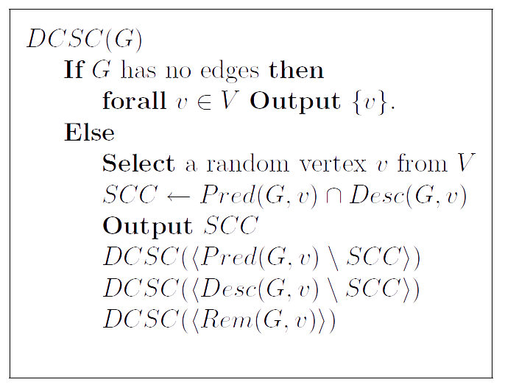
Pseudocode
TEAM - 11

Slide 22
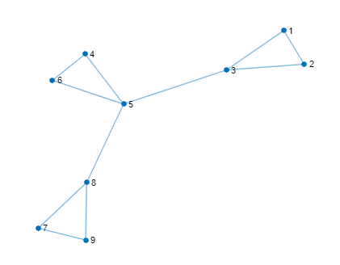
OUTPUT :

Slide 23
Parallelization perspective
this algorithm has practical parallelization on
two levels.
The recursive invocations are completely independent and so can execute independently.
The searches for predecessors and descendants allow for much more parallelism than does a depth-first search.

Slide 24
OUR PRESENTATION FLOW
BFS - algebraic way
using BFS and finding Predecessors and Descendants
SCC - divide and conquer style
SCC - parallelizing the regular DFS algorithm
Graph Contraction

Slide 25
CONNECTED COMPONENTS
DEPTH-FIRST SEARCH

Slide 26
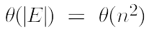
Connected Components
Undirected
Sequence Algoritm
Perform a DFS traversal on the graph. => forest
Each tree in the forest is a connected component.
runtime is for a dense graph.

Slide 27
Parallel Formulation
It is based on 3 principles:
Partition the adjacency matrix into p parts.
Each processor computes the DFS forest on the graph visible to it.
Merge the forests to get the complete final forest. => connected componenets

Slide 28
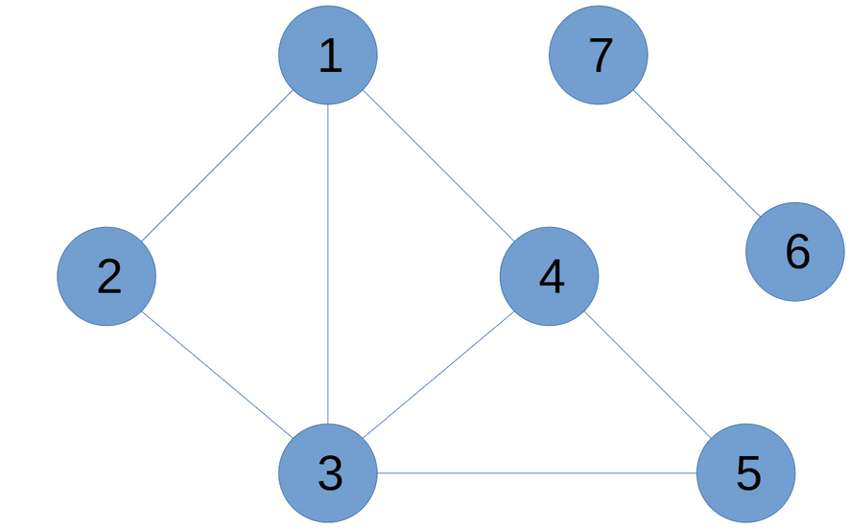
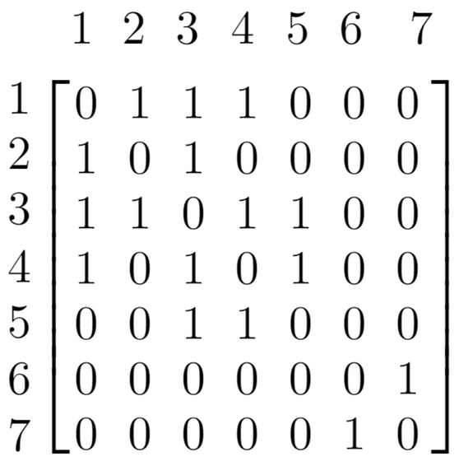
1st Formulation
Row wise partitioning of the adjacency matrix.
Adjacency Matrix:

Slide 29
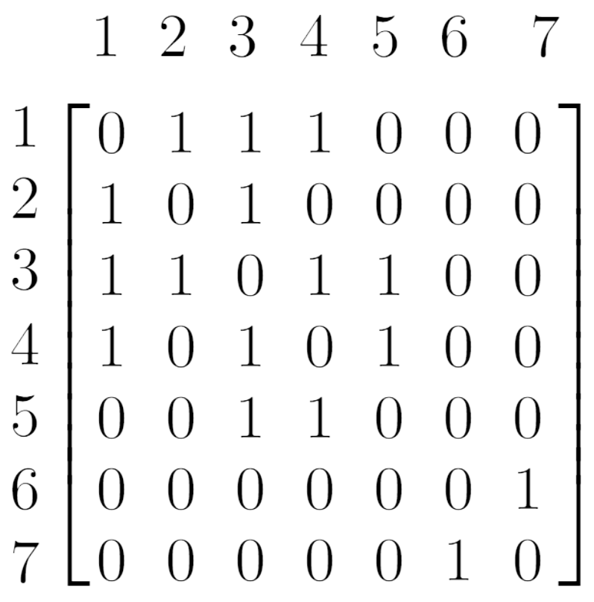
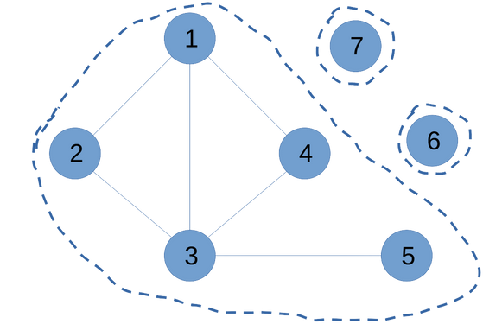
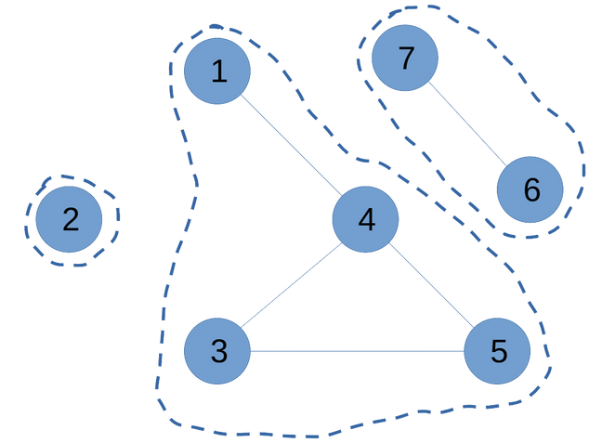
P1
P2
TEAM - 11

Slide 30
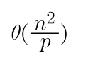
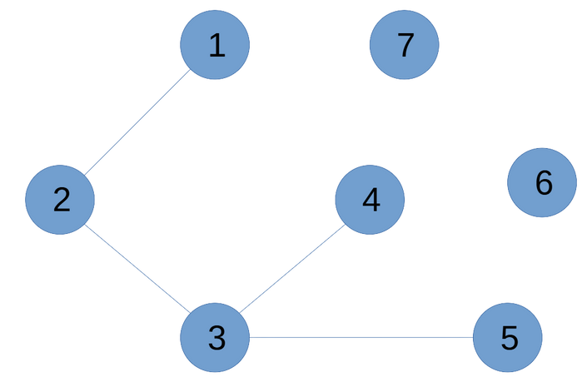
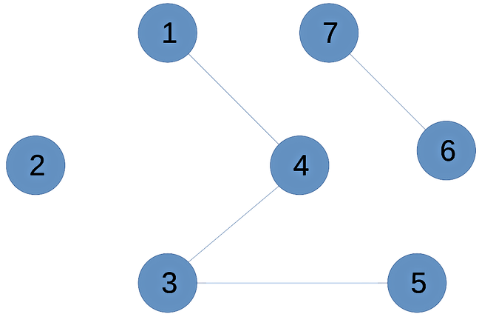
2nd Formulation
DFS on each processor:
=> number of edges or entries of the adjacency matrix visible on each processor
P1
P2

Slide 31
3rd Formulation
Merge the forests: Union find data structure.
find(u) - Identify the set it belongs to.
Merge(u,v) - Union/Merge the sets if u and v belongs to different sets.

Slide 32
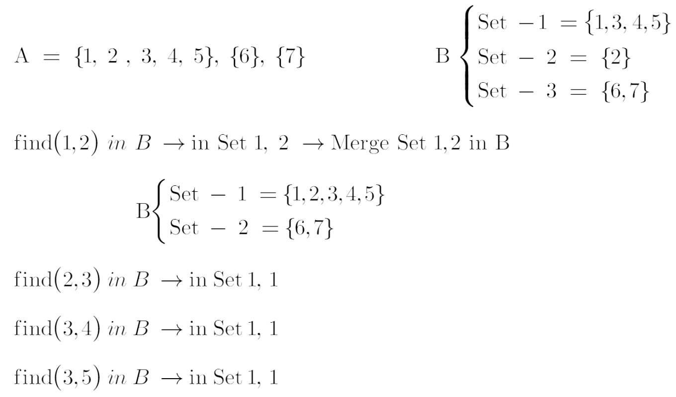

Slide 33
Merge A into B (update B)
Given two forests A & B:
For each edge (u,v) in A:
x = find(u) in B
y = find(v) in B
if x != y:
Merge(x,y) in B
We need to get log(p) iterations to get the final set/forest.

Slide 34
Graph Contraction
Contraction is a common operation in recursive compu?tations on graphs, appearing, for example, in some graph partitioning algorithms
and in numerical multigrid solvers.
TEAM - 11

Slide 35
Graph contraction can be implemented in parallel by
sparse matrix multiplication.
The input is a graph and an integer label for each node
merges nodes with the same label
TEAM - 11

Slide 36
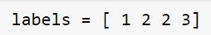
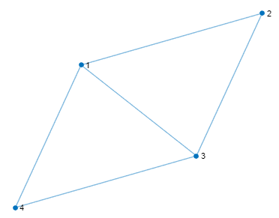
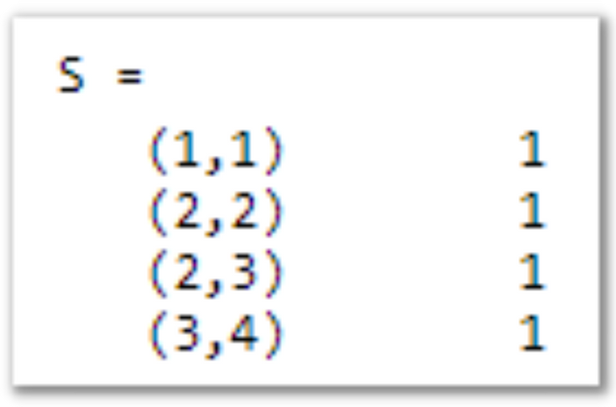
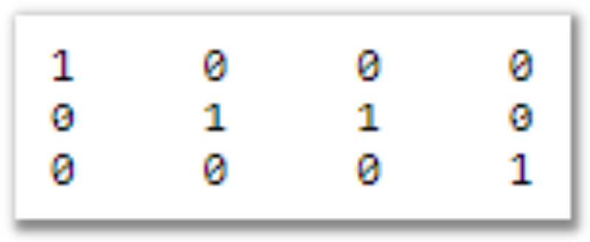
We from the sparse matrix S, which has a column for every node of the input graph
and a row for every node of the quotient graph.
TEAM - 11

Slide 37
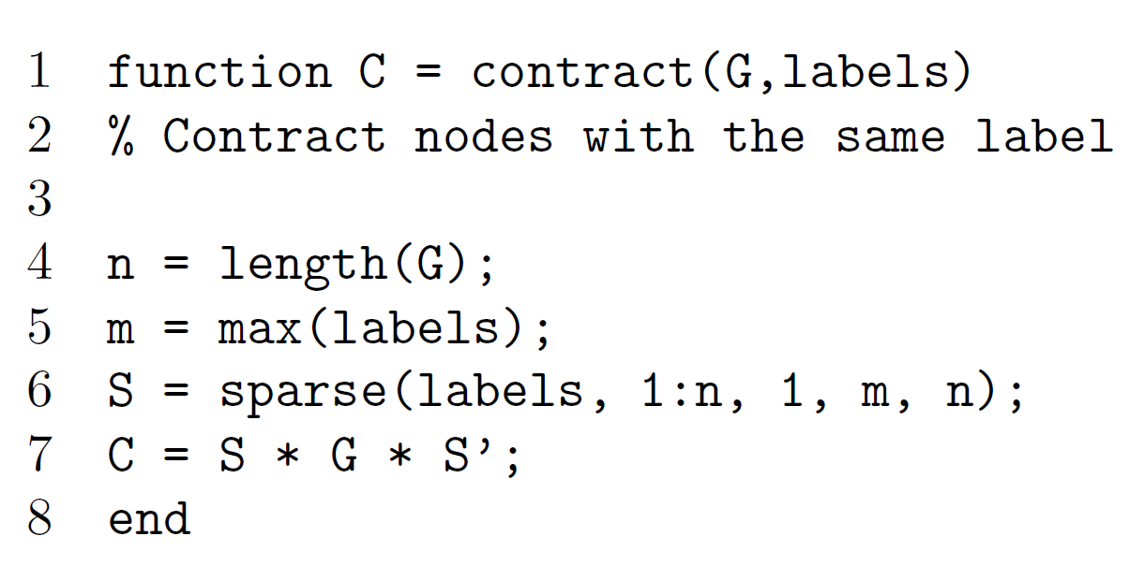
Complexity is 2*n^3
TEAM - 11

Slide 38

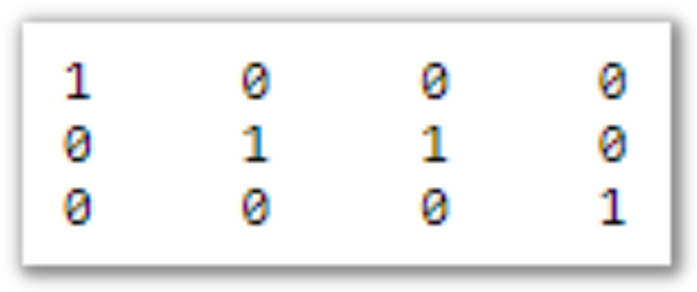
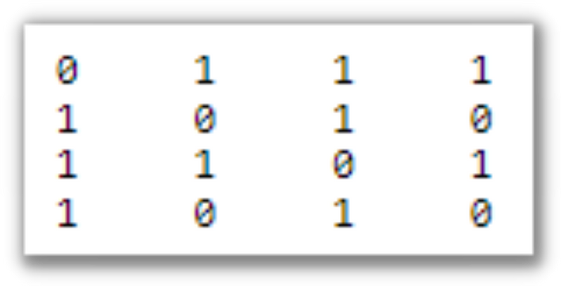
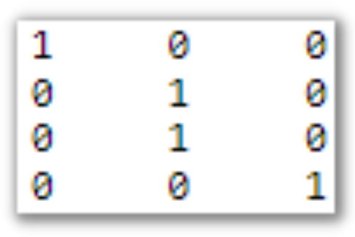
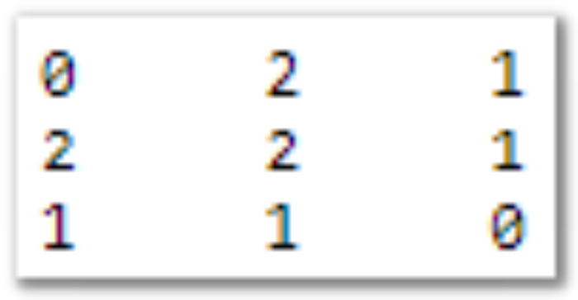

3 X 4
4 X 4
4 X 3
TEAM - 11

Slide 39
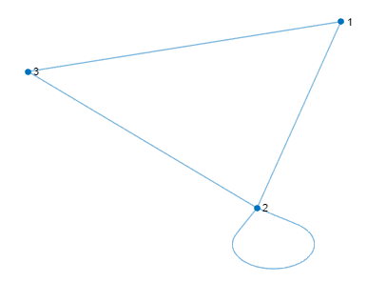
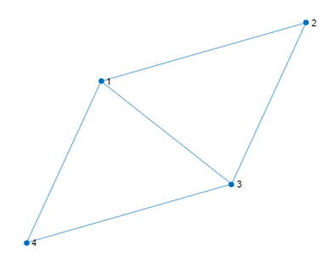
OUTPUT from our MATLAB implementation
TEAM - 11

Slide 40
Thank
you!
TEAM - 11

